Slide 1
Analyzing Neighbourhoods of Chennai For Starting A New Restaurant.
PERUMAL RAJENDRAN
IBM Applied Data Science
02.01.2021

Slide 2

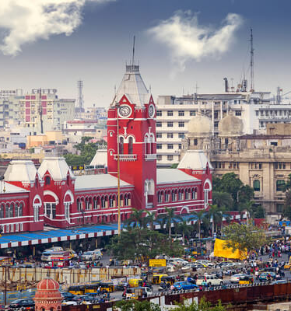
Introduction
CHENNAI is the capital of Tamil Nadu. It is one of the most important metros in India. The region around Chennai has served as an important administrative, military, and economic center for many centuries.
The city is full of restaurants serving thousands of hungry customers, every day. The diversity in the population of the city has brought in a vast diversity in food habits of people.
In this project we will study the neighborhoods and make recommendations accordingly.

Slide 3
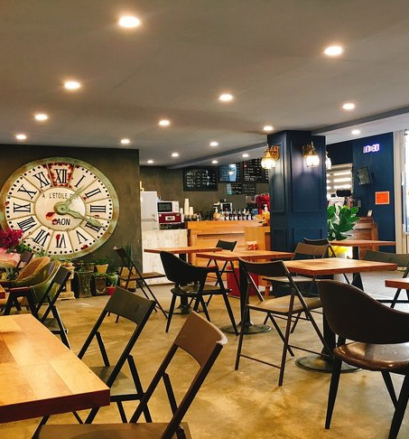
Business Problem
Start a restaurant
Neighbourhood that is most likely to give a good business

Slide 4
Data
Neighbourhoods of Chennai
Neighbourhoods of Chennai wikipedia page through data scraping.
Geographical coordinates of the neighbourhoods
Using GeoPy library.
Venue data from FourSquare
Using FourSquare API

Slide 5
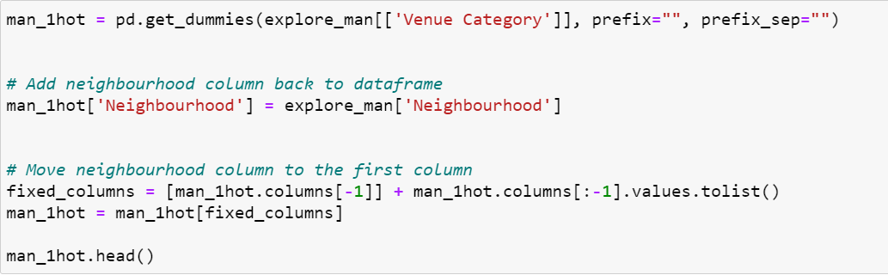
Methodology
Feature Extraction
One Hot Encoding

Slide 6
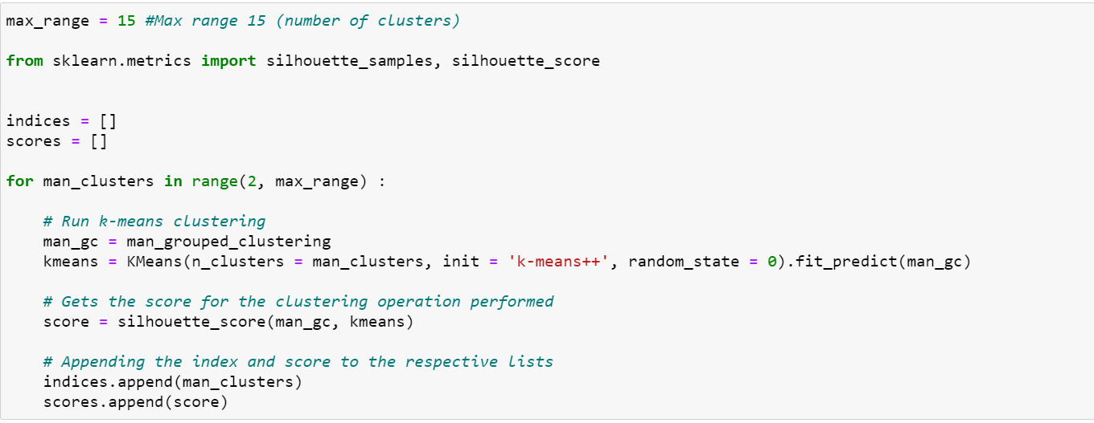
Unsupervised Learning
K-Means Clustering

Slide 7
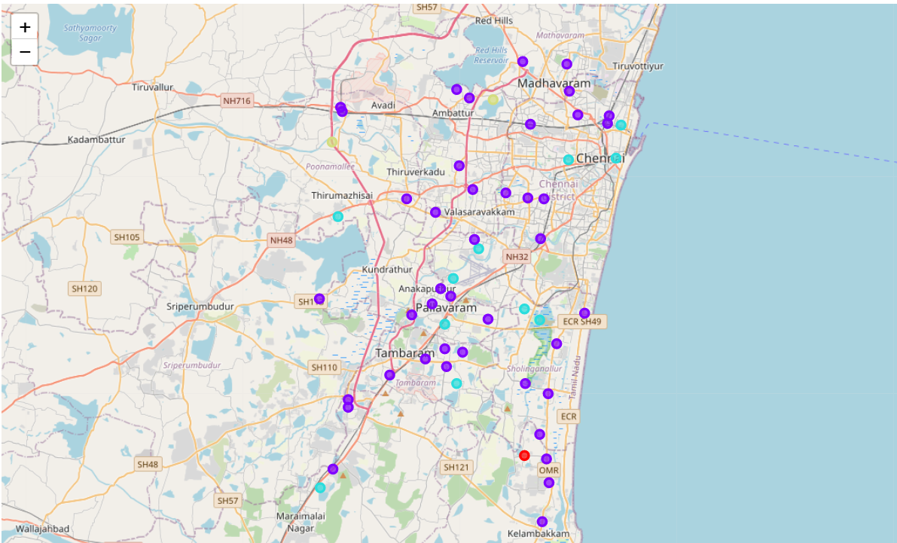
Plotting
Folium

Slide 8
Results
Visualization of clusters
After visualizing the clusters, the individual clusters were studied, and some important conclusions were derived. The neighbourhood that had the more number of restaurants was cluster number 3.

Slide 9
Discussion
Most suitable neighbourhoods for starting the restaurant business are present in the cluster number 3.
Our K-Means model worked perfectly and successfully clustered similar neighbourhoods together.
After studying all four clusters, it is recommended to the client that neighbourhoods such as Chromepet, Kilpauk and Cowl Bazaar that fall in cluster 3 look like good locations for starting their restaurant business.
The client can go ahead and make a decision depending on other factors like availability and legal requirements that are out of scope of this project.

Slide 10
Conclusion
Data analysis and machine learning techniques used in this project can be very helpful in determining solutions of certain business problems.
Python’s inbuilt libraries such as GeoPy, Folium and BeautifulSoup make it very easy and effective to analyze a geographical location.
In this project we studied the neighbourhoods of Chennai city and came up with a recommendation of neighbourhoods where our client can start their restaurant business.

